Slide 1
Student Training Remote Learning

Slide 2
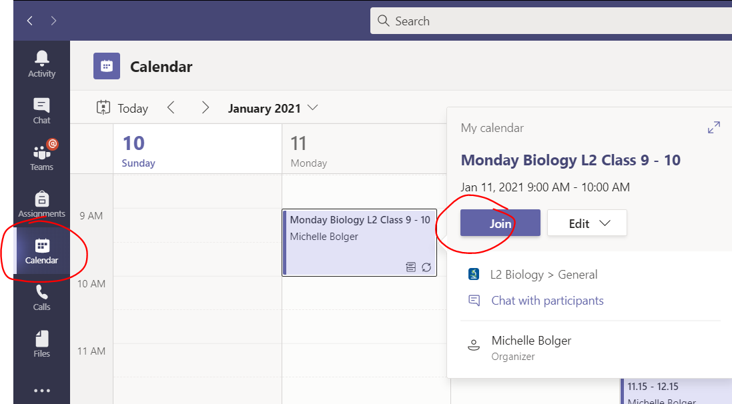
Remote Learning Live Class
The teacher will create a class, which can be accessed through the calendar.
Click the appropriate class and hit join to enter the lobby. The teacher will the admit you to the class.
Enter the lobby muted and with your camera on. Only blur the background if you wish. Do not use any other background.

Slide 3
Microphone symbol – mute/unmute.
Camera symbol – on/off.
Hand symbol – press if you want to ask a question. Wait for the teacher to call you to unmute.
Chat bubble symbol – for chat function. Use only to discuss class content.
Leave – to leave the lesson.

Slide 4
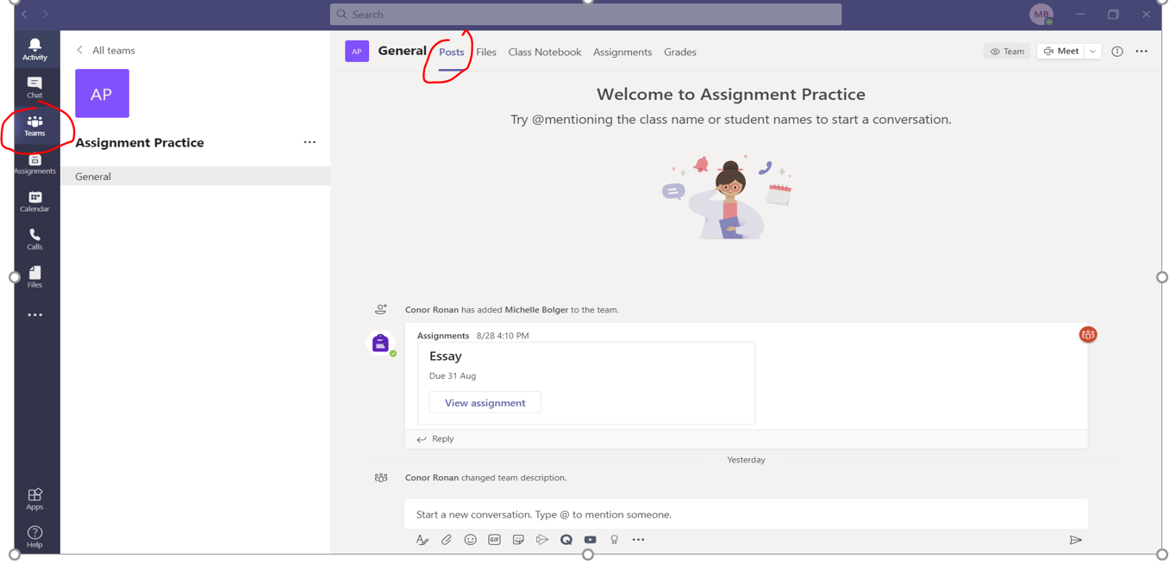
Remote Learning Pre-recorded
The teacher will post a message in the Teams site, giving information on how to access the pre-recorded lesson and all lesson instructions.

Slide 5
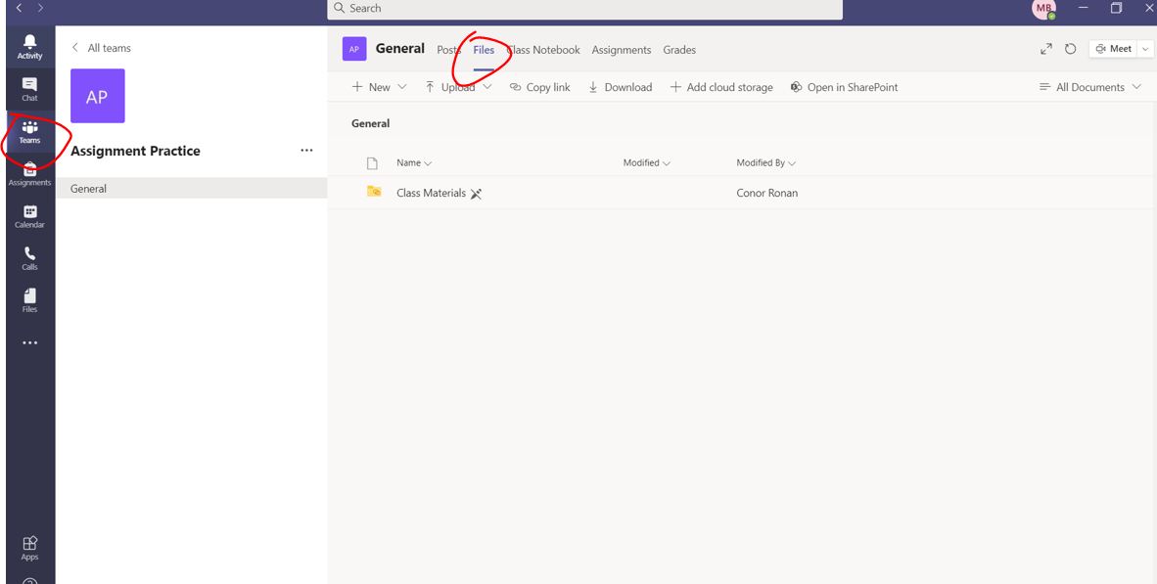
Remote Learning Pre-recorded
Pre-recorded lessons will normally be saved in the files section of the Team.
Ensure to follow the teachers instructions and to engage in the pre-recorded lesson during the time assigned for that class.

Slide 6
Remember!
The app on a phone/tablet will have a slightly different interface than the windows 10 version.

